Slide 1

High Volatility Portfolio
Universidad de las Américas Puebla
P24-LII2042-3: Teoría y Técnicas de Optimización
Dr. Abraham Benito Barragán Amigón
Abril de 2024

Slide 2

Description
For this project, an investment portfolio was created by analyzing both market trends and microeconomic factors. Through the application of essential conditions, including objective functions and constraints, our aim is to maximize client profits while mitigating risks.

Slide 3

Feasibility analysis
This project is feasible due to the well-diversified nature of the portfolio, resulting in lower overall volatility. Consequently, it assures a consistent and distinct return compared to investing solely in government bonds.

Slide 4

Goal
Create investment portfolios in which the expected return or value of companies is maximized. This way, the most optimal portfolio is crafted to maximize profits while reducing risk.

Slide 5

Technical Analysis
The fundamental analysis for the construction of this portfolios is bottom up, to show the difference between the risk preferences, from the percentage that would go to action to the selection of stocks according to their volatilities.

Slide 6
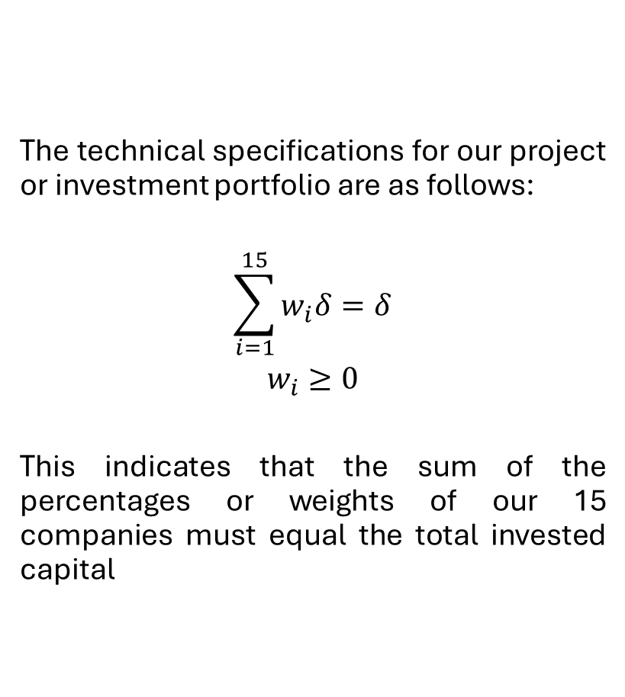
Technical specifications
The technical specifications for our project or investment portfolio are as follows:
$$\sum_{i=1}^{15}{w_{i}δ=δ}$$
$$w_{i}≥0$$
This indicates that the sum of the percentages or weights of our 15 companies must equal the total invested capital

Slide 7

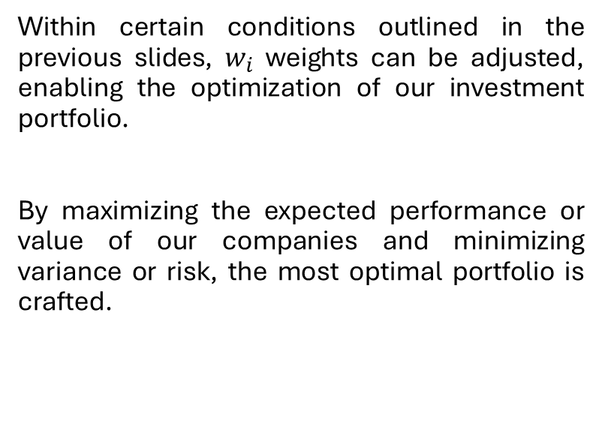
Hypothesis
Within certain conditions outlined in the previous slides, $w_{i}$ weights can be adjusted, enabling the optimization of our investment portfolio.
By maximizing the expected performance or value of our companies and minimizing variance or risk, the most optimal portfolio is crafted.

Slide 8
Rules and regulations It is prohibited:
Fraudulent practices by Administrators
Speculative operations that compromise financial stability
Diversion of funds for unauthorized or illegal purposes
Lack of adequate supervision and control mechanisms

Slide 9

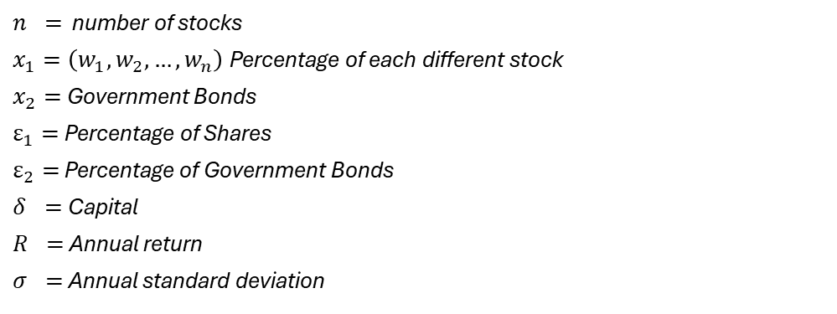
Objectives
Maximize the return
s.a.
The sum of investments in Bonds and Stocks must equal the total capital invested.
The amount allocated to stocks cannot exceed the predetermined percentage of the total capital intended for investment.
The amount allocated to government bonds must be equal to or greater than the predetermined percentage of the total capital intended for investment.
With each new investment (indexed by 𝑚), its allocation in the portfolio should not exceed that of previous investments, arranged in order by return, to ensure diversification.
The product of the volatility of the stocks and their weight in the portfolio must be less than or equal to the average of the volatilities.
$n =$ number of stocks
$x_{1}=\left(w_{1}, w_{2}, …, w_{n}\right)$Percentage of each different stock
$x_{2}=$ Government Bonds
$ε_{1}=$Percentage of Shares
$ε_{2}=$ Percentage of Government Bonds
$δ =$ Capital
$R =$ Annual return
$σ =$ Annual standard deviation

Slide 10
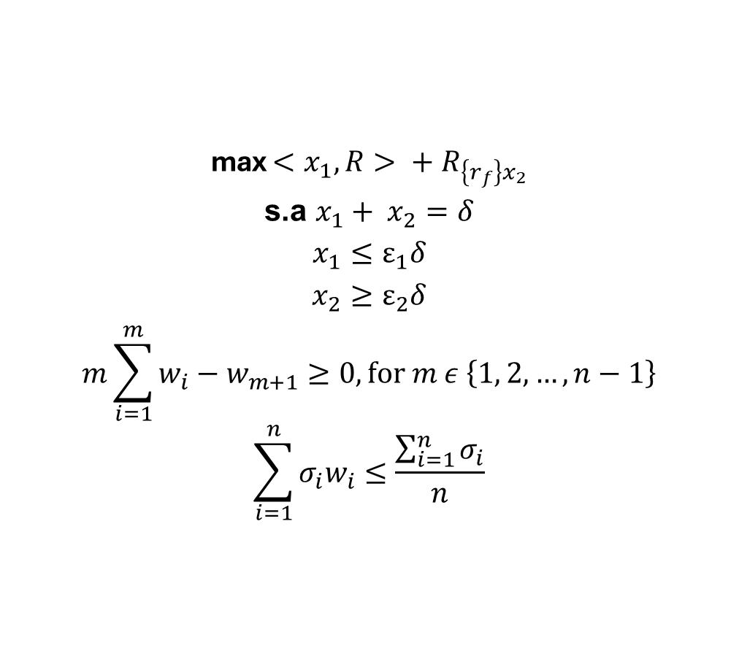
Objectives
max $<x_{1},R> + R_{\left\{r_{f}\right\}x_{2}}$
$${\text{s}\text{.}\text{a} x}_{1}+ x_{2}=δ$$
$$x_{1}≤ε_{1}δ$$
$$x_{2}≥ε_{2}δ$$
$$m\sum_{i=1}^{m}{w_{i}}−w_{m+1}≥0, for m ε \left\{1, 2, …, n−1\right\}$$
$$\sum_{i=1}^{n}{σ_{i}w_{i}}≤\frac{\sum_{i=1}^{n}{σ_{i}}}{n}$$
$n =$ number of stocks
$x_{1}=\left(w_{1}, w_{2}, …, w_{n}\right)$Percentage of each different stock
$x_{2}=$ Government Bonds
$ε_{1}=$Percentage of Shares
$ε_{2}=$ Percentage of Government Bonds
$δ =$ Capital
$R =$ Annual return
$σ =$ Annual standard deviation

Slide 11
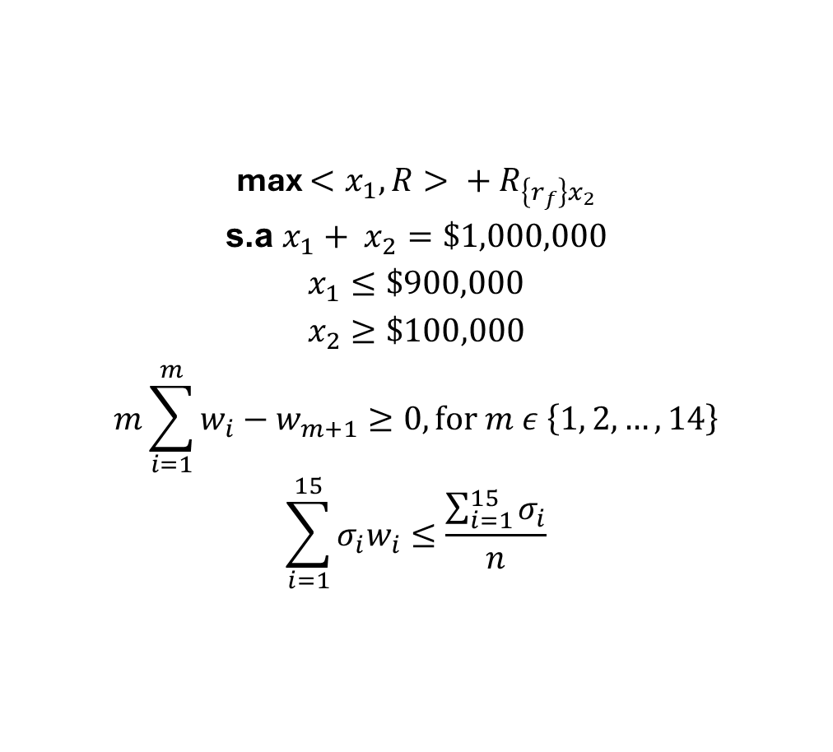
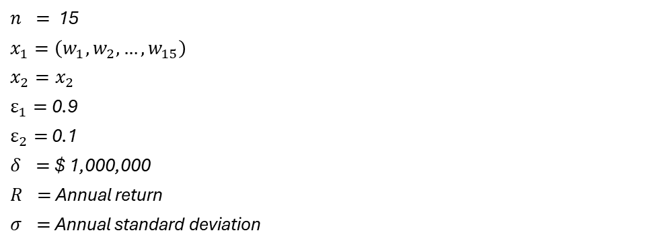
Objectives
max $<x_{1},R> + R_{\left\{r_{f}\right\}x_{2}}$
s.a $x_{1}+ x_{2}=\$1,000,000$
$$x_{1}≤\$900,000$$
$$x_{2}≥\$100,000$$
$$m\sum_{i=1}^{m}{w_{i}}−w_{m+1}≥0, for m ε \left\{1, 2, …, 14\right\}$$
$$\sum_{i=1}^{15}{σ_{i}w_{i}}≤\frac{\sum_{i=1}^{15}{σ_{i}}}{n}$$
$n =$ 15
$x_{1}=\left(w_{1}, w_{2}, …, w_{15}\right)$
$x_{2}=x_{2}$
$ε_{1}=$0.9
$ε_{2}=$ 0.1
$δ =$ $ 1,000,000
$R =$ Annual return
$σ =$ Annual standard deviation

Slide 12

Methodology for Project Development
Selection of the 15 most volatile stocks
Analysis of performance and variance of returns based on price data over time
Create a DataFrame with the information of the stocks from the last 6 months
Asume return as
Use of solver to find the solution to the planned problem.
$$\ln\left( \frac{p_{t}}{p_{t−1}}\right)$$

Slide 13

Selected stocks According to Yahoo Finance, the most volatile stocks were the following:
AFRM
AMAT
AMD
BABA
MU
NIO
NVDA
ON
RIOT
SAVA
SPCE
SQ
TSLA
WISH
XPEV

Slide 14

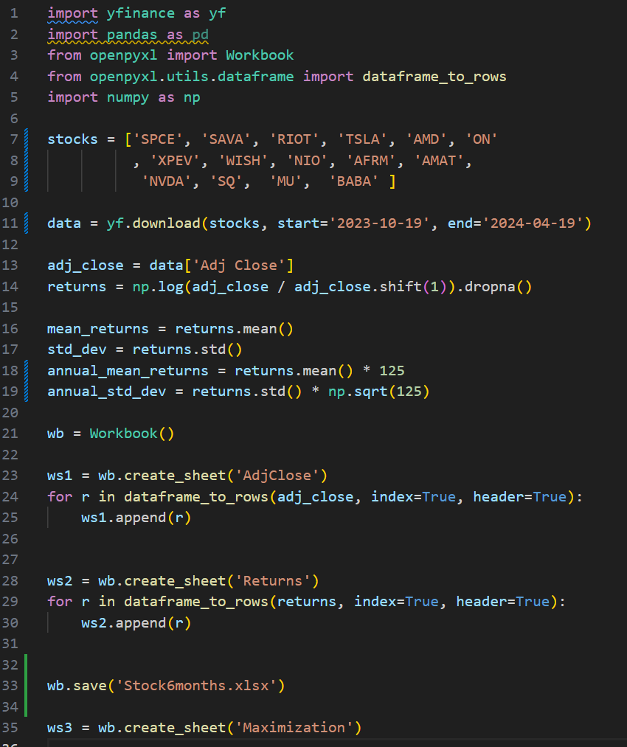
Create Data Frame
Given the code, we can export the Data Frame to Excel

Slide 15
Adj. Close
Extract the Adjusted Close prices from the selected 15 most volatile stocks and create a DataFrame

Slide 16


Returns
Apply the returns as $\ln\left( \frac{p_{t}}{p_{t−1}}\right)$
$$\ln\left( \frac{p_{t}}{p_{t−1}}\right)$$

Slide 17

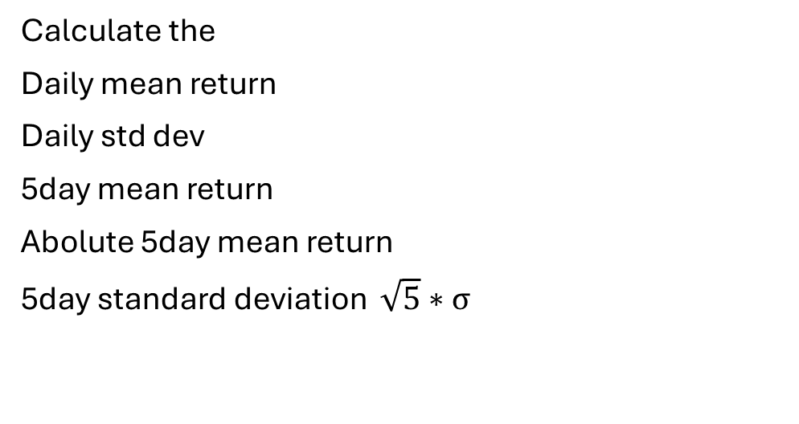
Data
Calculate the
Daily mean return
Daily std dev
5day mean return
Abolute 5day mean return
5day standard deviation $\sqrt{5}∗σ$

Slide 18
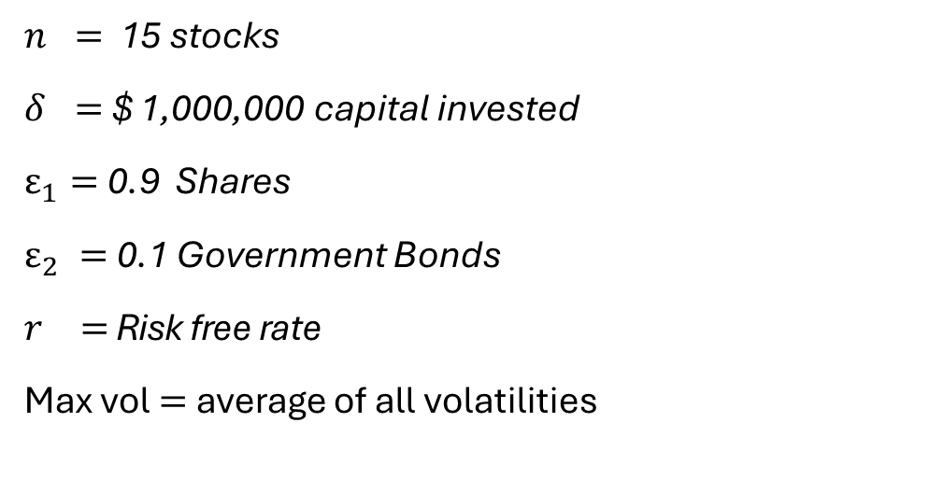
Parameters
$n =$ 15 stocks
$δ =$ $ 1,000,000 capital invested
$ε_{1}=$0.9 Shares
$ε_{2} =$ 0.1 Government Bonds
$r =$ Risk free rate
Max vol$=$average of all volatilities

Slide 19
Solutions
Solver found the following solution that satisfies all the restrictions:

Slide 20
Restrictions
The sum of investments in Bonds and Stocks must equal the total capital invested.
The amount allocated to stocks cannot exceed the predetermined percentage of the total capital intended for investment.
The amount allocated to government bonds must be equal to or greater than the predetermined percentage of the total capital intended for investment.
With each new investment (indexed by 𝑚), its allocation in the portfolio should not exceed that of previous investments, arranged in order by return, to ensure diversification.
The product of the volatility of the stocks and their weight in the portfolio must be less than or equal to the average of the volatilities.

Slide 21
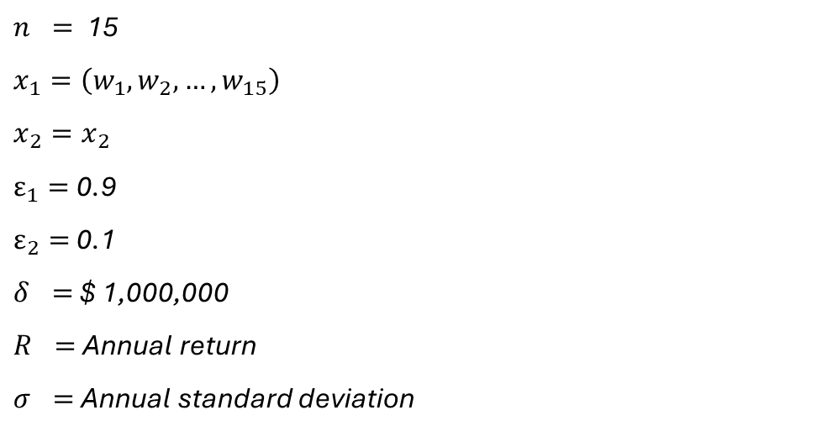
Restrictions
$n =$ 15
$x_{1}=\left(w_{1}, w_{2}, …, w_{15}\right)$
$x_{2}=x_{2}$
$ε_{1}=$0.9
$ε_{2}=$ 0.1
$δ =$ $ 1,000,000
$R =$ Annual return
$σ =$ Annual standard deviation

Slide 22
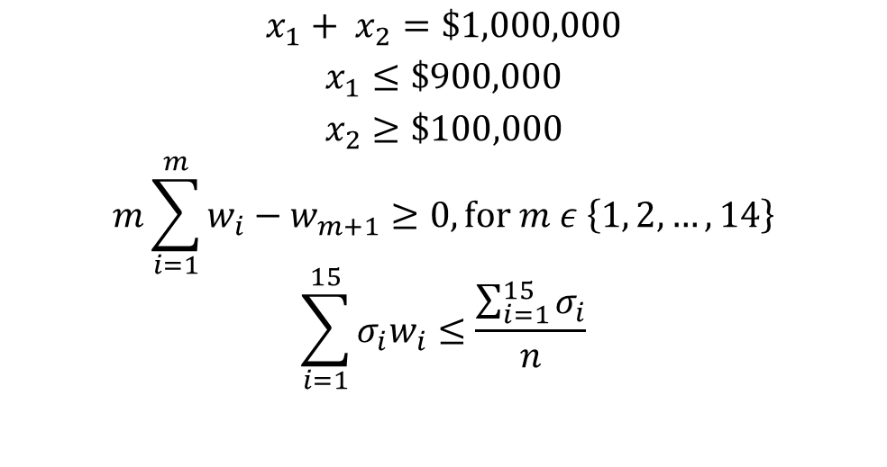
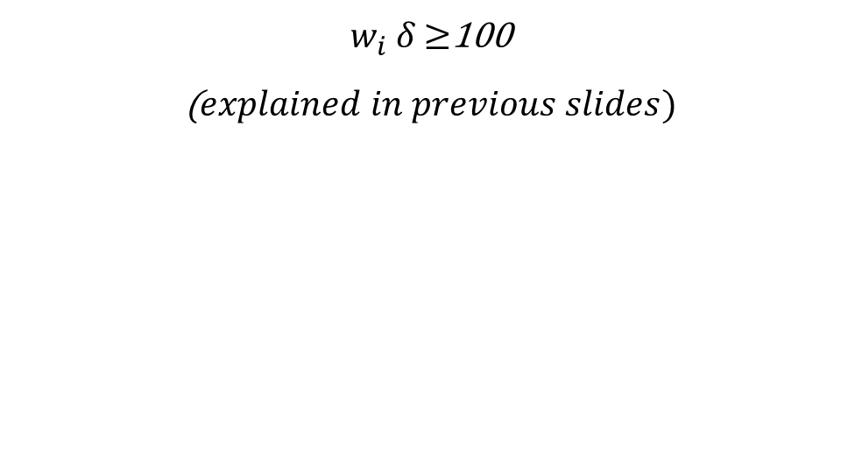
Restrictions
$$x_{1}+ x_{2}=\$1,000,000$$
$$x_{1}≤\$900,000$$
$$x_{2}≥\$100,000$$
$$m\sum_{i=1}^{m}{w_{i}}−w_{m+1}≥0, for m ε \left\{1, 2, …, 14\right\}$$
$$\sum_{i=1}^{15}{σ_{i}w_{i}}≤\frac{\sum_{i=1}^{15}{σ_{i}}}{n}$$
$w_{i}$ $δ$ $≥$100
($explained in previous slides)$

Slide 23
Sensitivity Analysis
This report details decision variables, optimal values, costs, coefficients, and allowable changes.

Slide 24
Sensitivity Analysis
As stated in the report, maximizing investment in NVDA is desirable. However, due to imposed restrictions, the portfolio must be diversified across the remaining 14 stocks.

Slide 25
Sensitivity Analysis
Allocating the entire capital into stocks is preferable since government bonds offer lower returns compared to stocks.

Slide 26
Sensitivity Analysis
Followed by previous slides, the analysis shows that our portfolio's profits would improve if there were no volatility restriction.

Slide 27
Conclusions
This portfolio is structured with 90% of the capital allocated to the stock market and the remaining 10% invested in bonds. It exclusively comprises stocks exhibiting significant volatility, synonymous with higher risk. Designed for investors comfortable with risk, the portfolio focuses on high-return opportunities, exemplified by stocks such as NVDA.
In an ideal scenario, showcasing the pie chart, this allocation could potentially yield an additional $24,074.33 within 5 days, assuming an initial investment of $1,000,000.

Slide 28

Bibliography
Cámara de Diputados del H. Congreso de la Unión. (2024). Ley de Fondos de Inversión. Recuperado de diputados.gob.mx.
Kabir, U. (2023). 15 Most Volatile Stocks To Buy Now. Recuperado de yahoo.com.
Meza, J. P. (2017). Aplicación de modelo de optimización de portafolios financieros en el Mercado Integrado Latinoamericano. Recuperado de intellectum.unisabana.edu.co.
Ortiz Ambriz, A. (2010). Optimización de Portafolios de Inversión con Restricción de Cardinalidad en Espacios Grandes de Acciones. Recuperado de repositorio.tec.mx.

